Slide 1
HOSPITAL BOOKING MANAGEMENT
APPOINTMENT BOOK

Slide 2
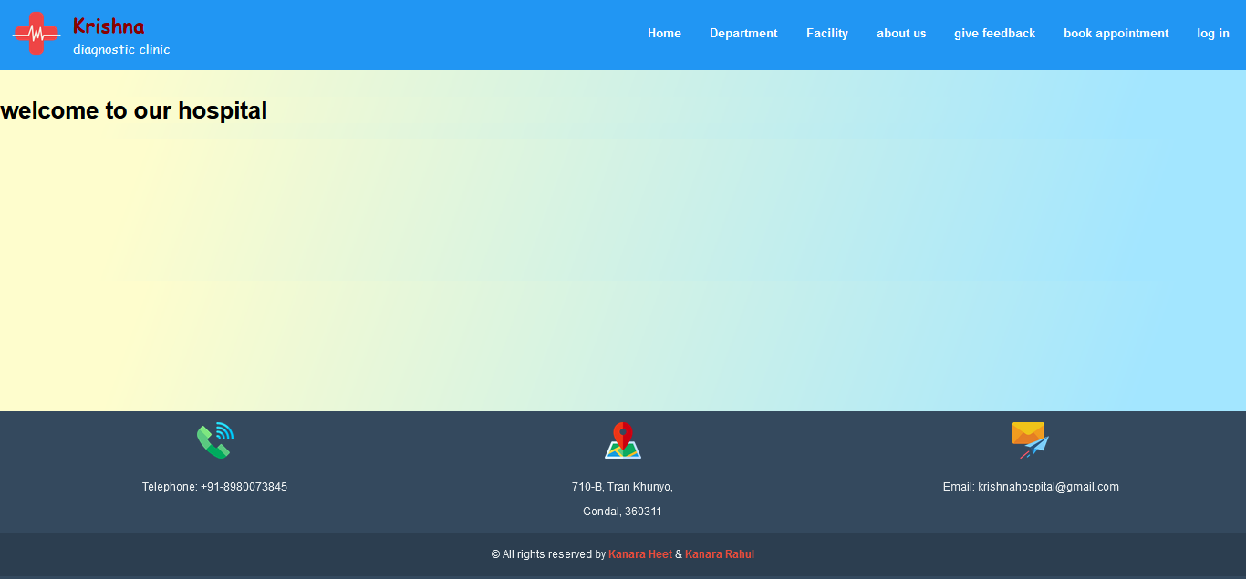
Home page

Slide 3
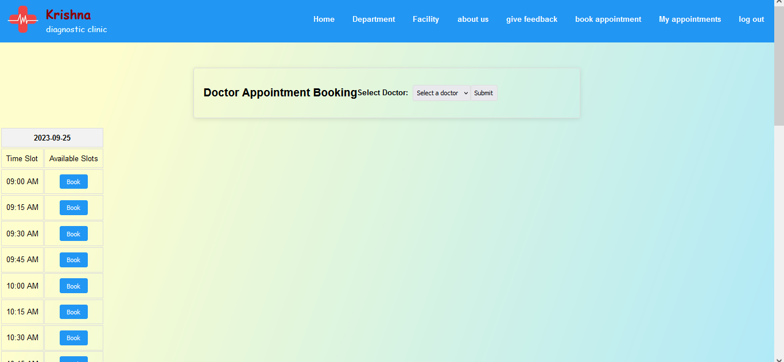
Home page

Slide 4
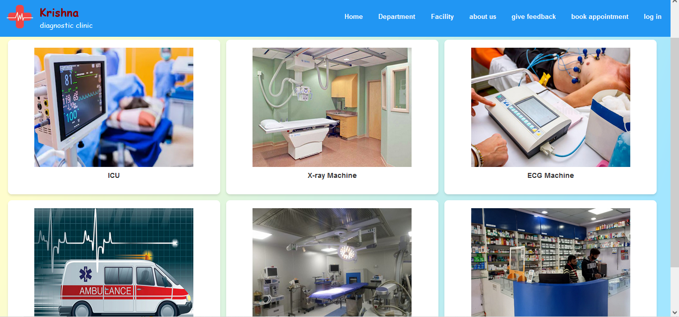
Home page

Slide 5
Home page

Slide 6
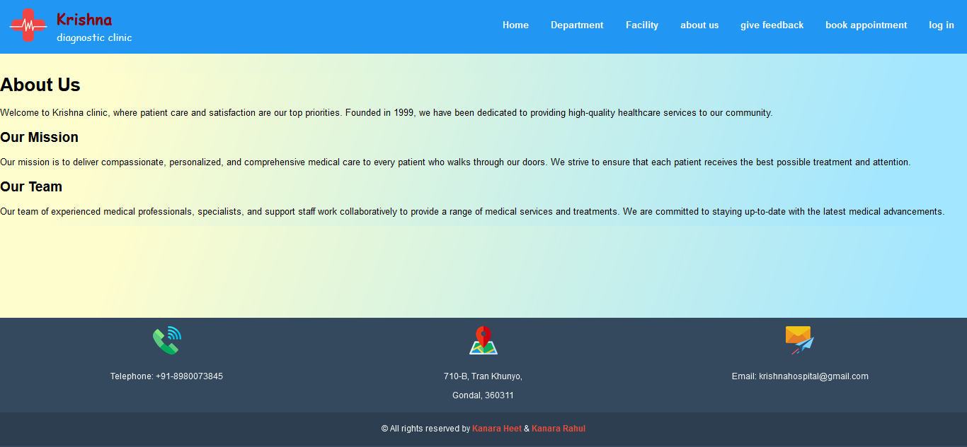
Home page

Slide 7
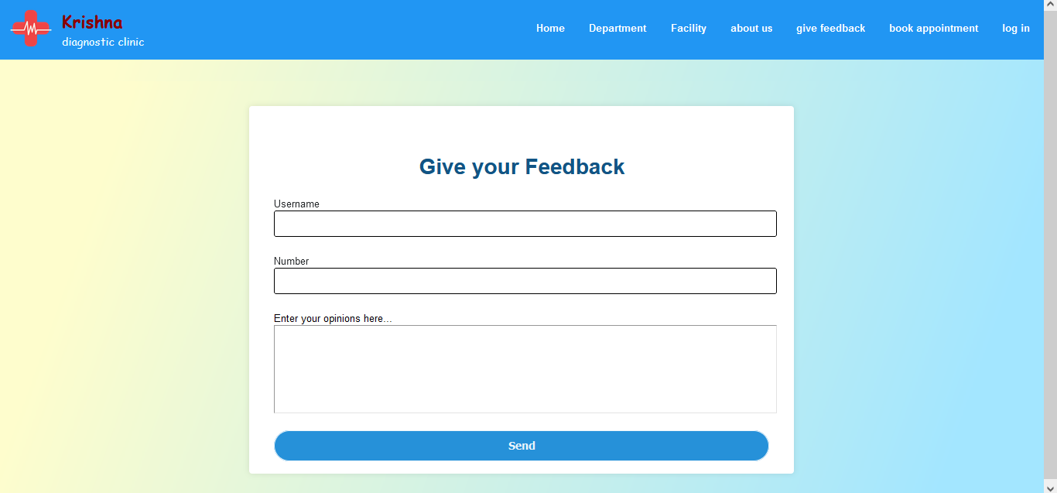
Home page

Slide 8
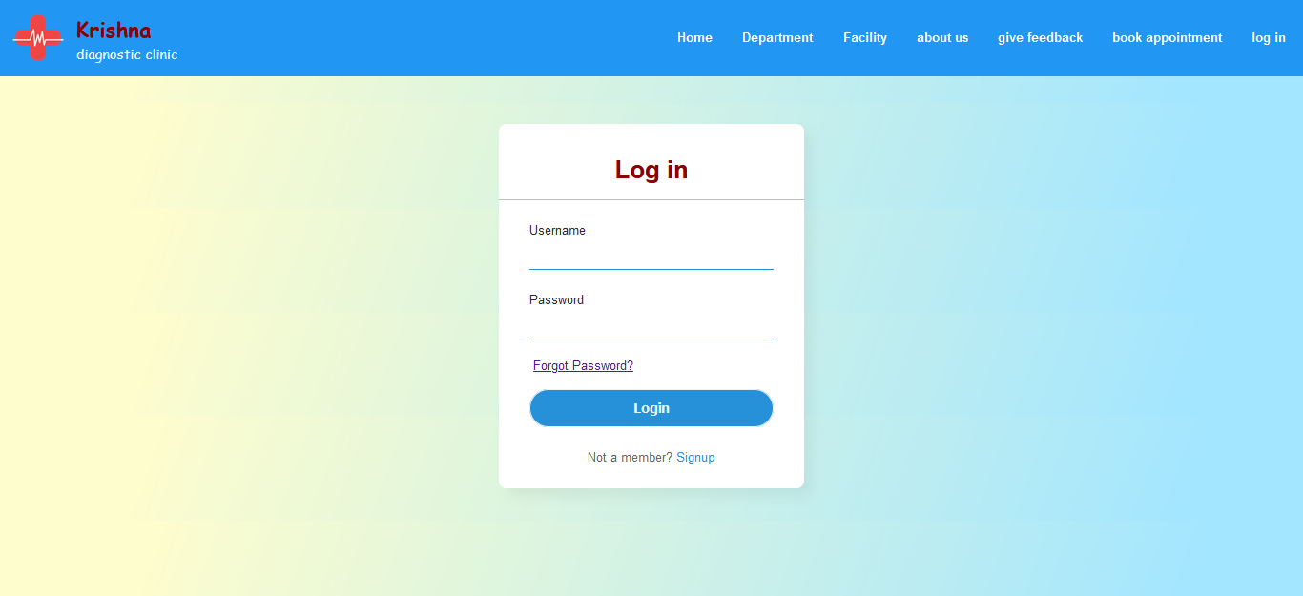
Login page

Slide 9
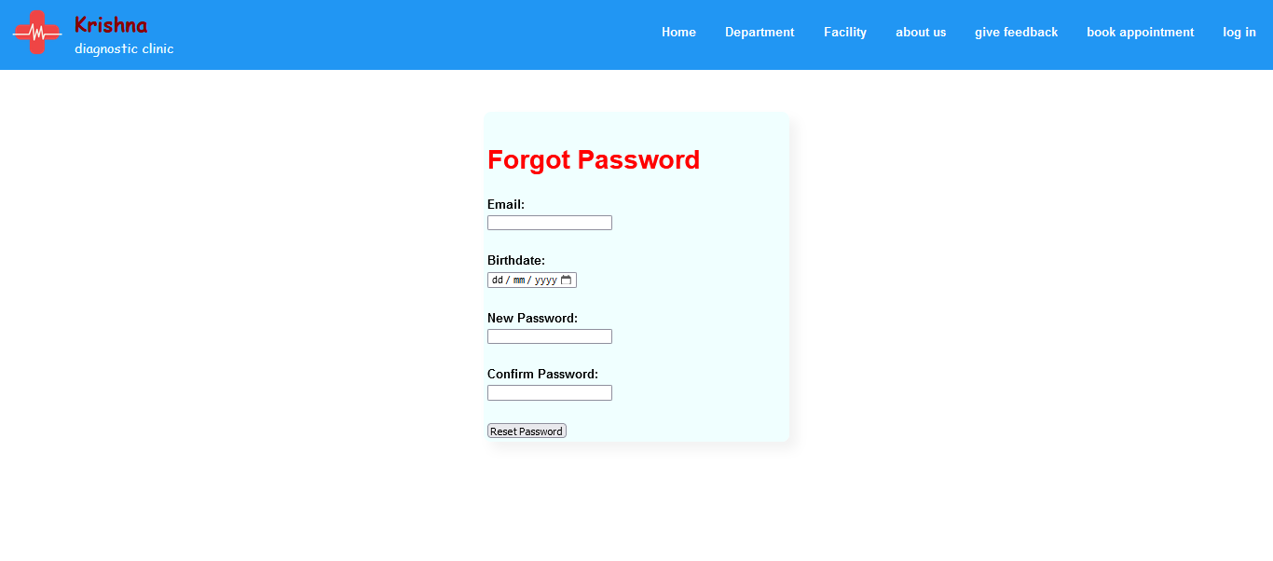
Forget password page

Slide 10
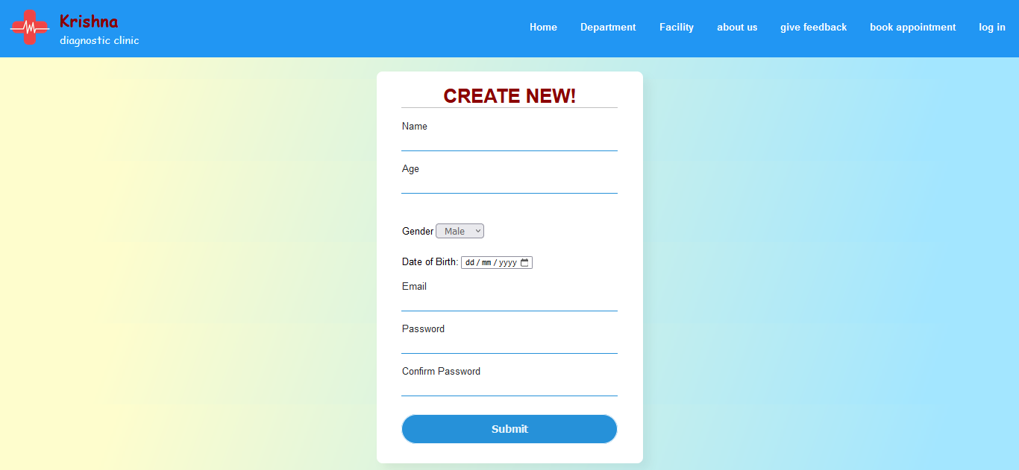
New User

Slide 11
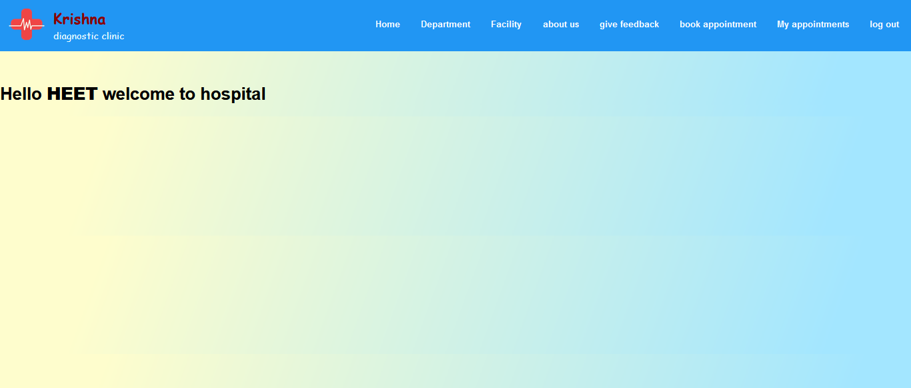
User Home page

Slide 12
User Home page

Slide 13
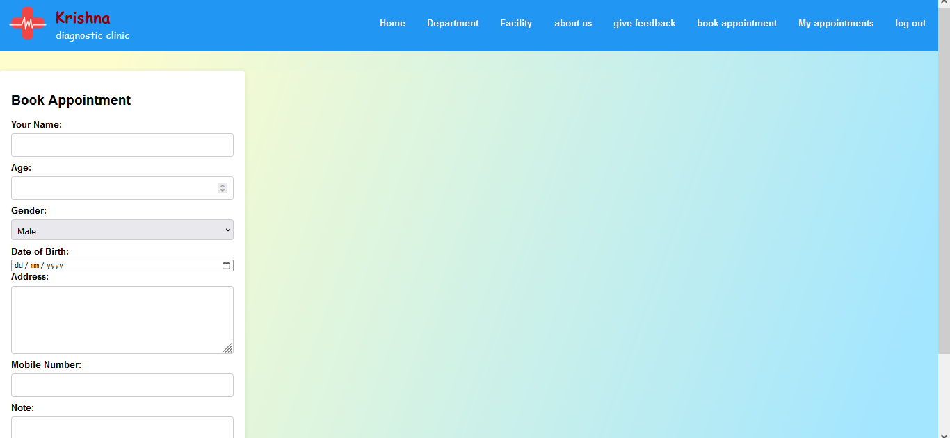
User Home page

Slide 14
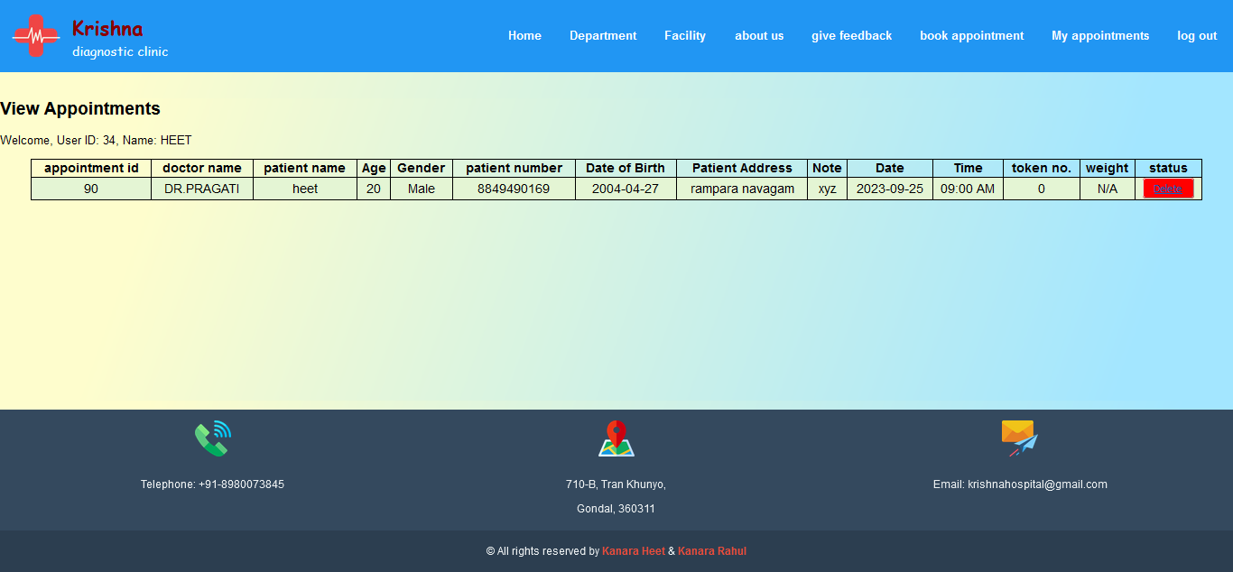
User Home page

Slide 15
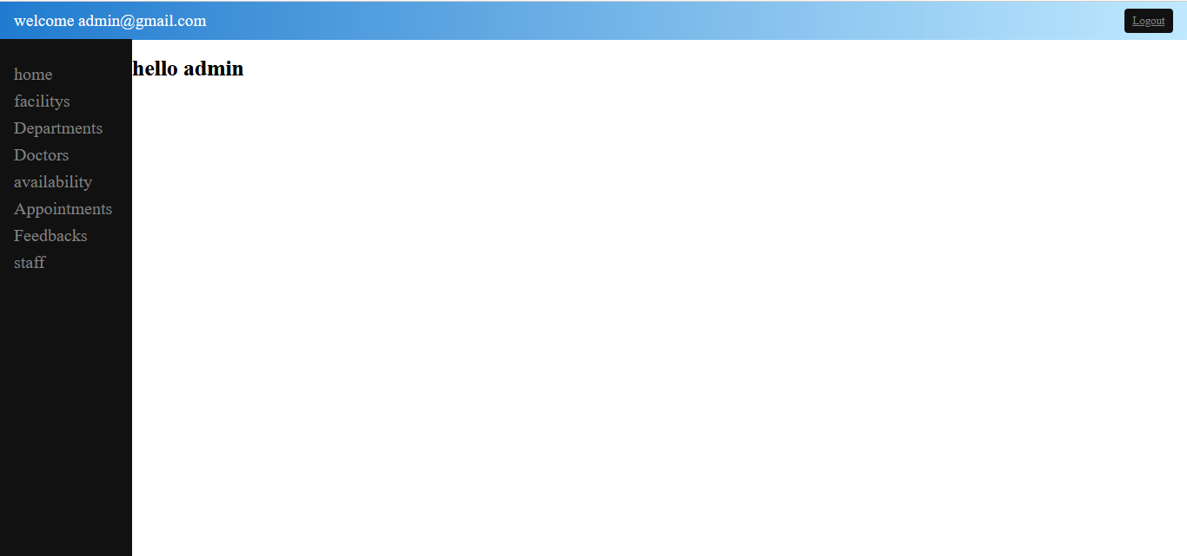
Admin home

Slide 16

Admin

Slide 17

Admin

Slide 18

Admin

Slide 19
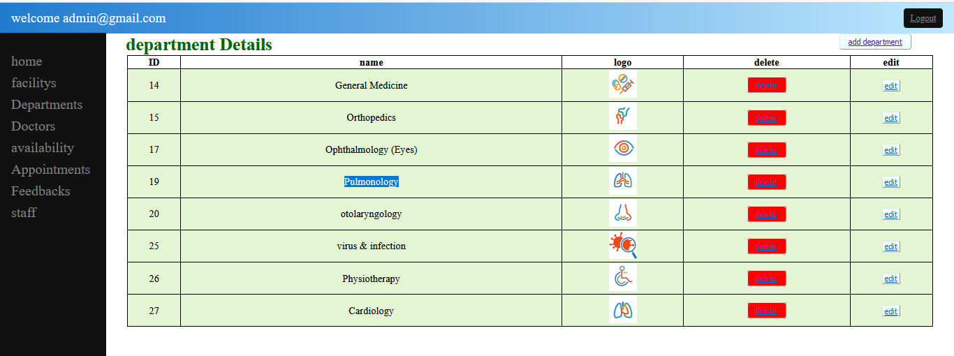
Admin

Slide 20

Admin

Slide 21

Admin

Slide 22

Admin

Slide 23

Admin

Slide 24

Admin

Slide 25

Admin

Slide 26
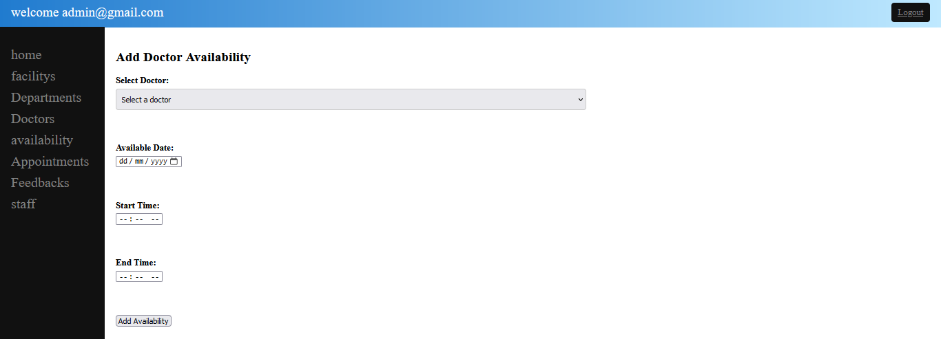
Admin

Slide 27

Admin

Slide 28

Admin

Slide 29

Admin

Slide 30

Doctor Home Page

Slide 31

Receptionist Home Page

Slide 32
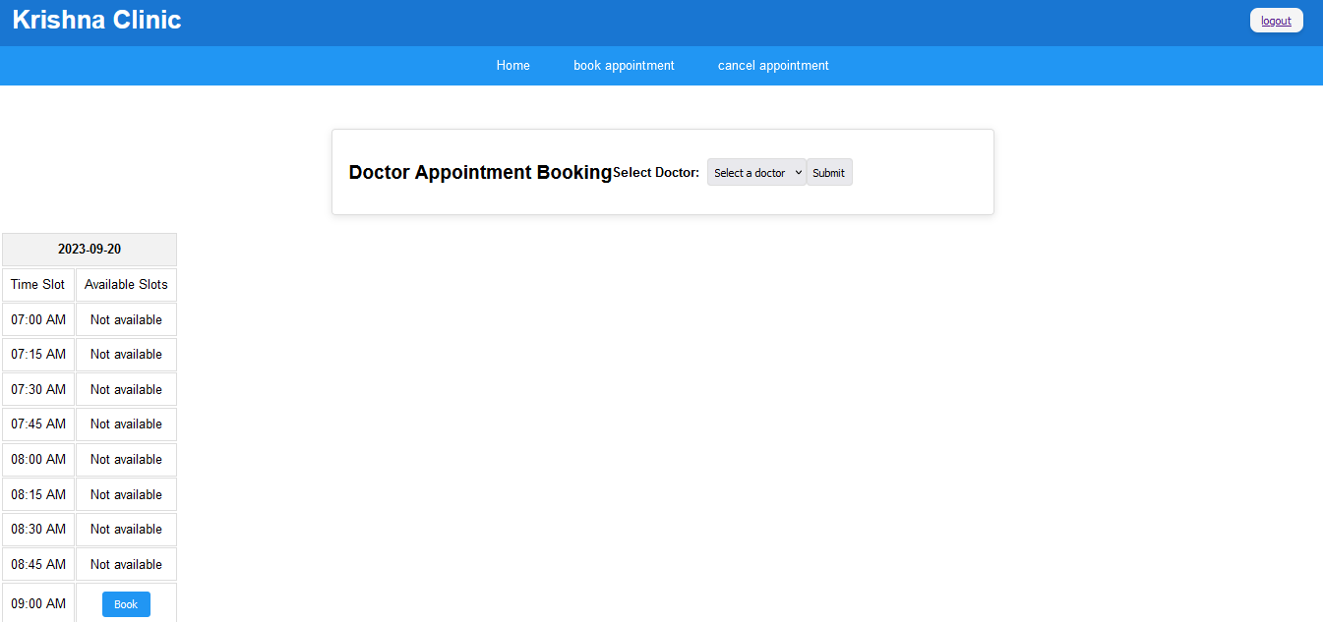
Receptionist Home Page

Slide 33
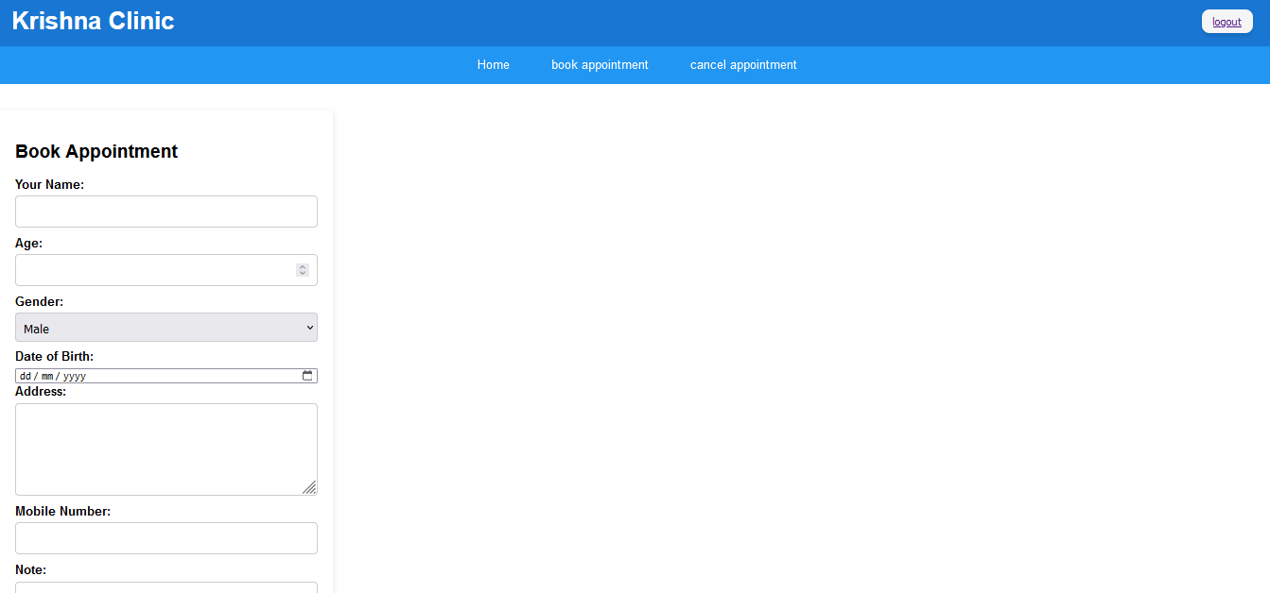
Receptionist Home Page

Slide 34
Receptionist Home Page

Slide 35

Receptionist Home Page

Slide 36
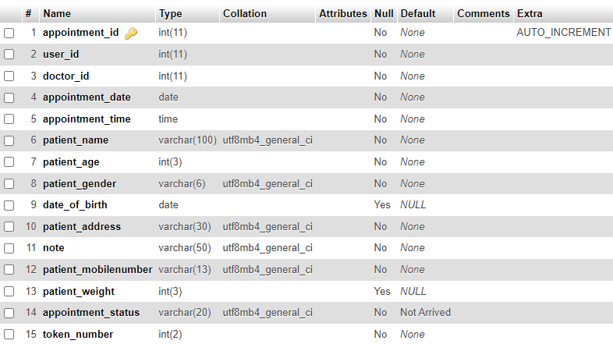
DataBase Table

Slide 37

DataBase Table

Slide 38

DataBase Table

Slide 39
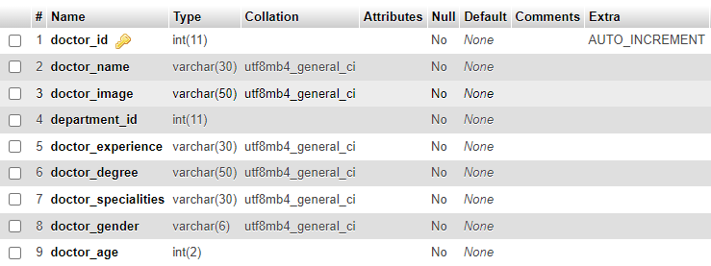
DataBase Table

Slide 40

DataBase Table

Slide 41

DataBase Table

Slide 42
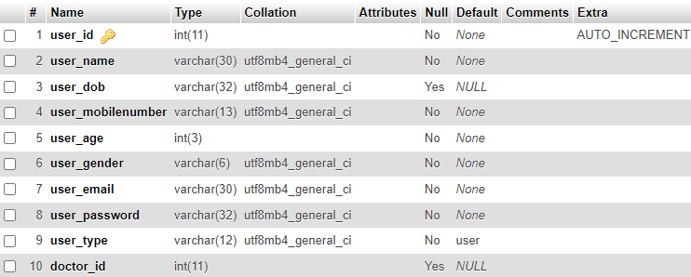
DataBase Table

